Slide 1
WELCOME

Slide 2

Data Communication and Computer Networks
Instructor:
Muhammad Daud Abbasi
Email: daud.abbasi@iqra.edu.pk
Lecture 2

Slide 3
Datalink layer

Slide 4
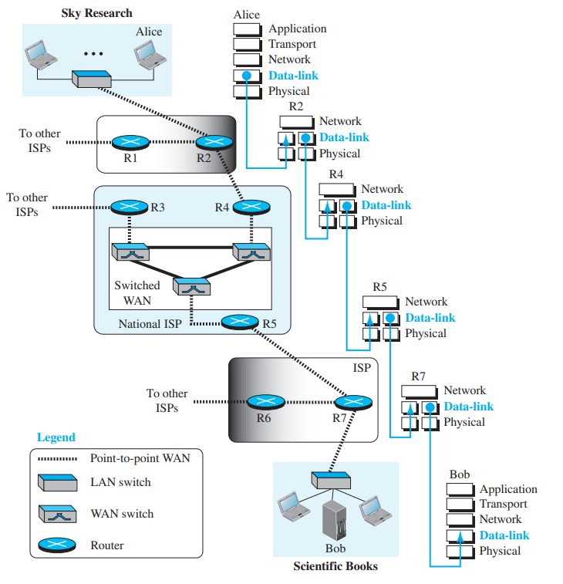
Learning Outcomes
Understanding of:
Data Communication components and characteristics

Slide 5
Data Link Layer
The Services Provided by the Link Layer
It is responsible for transmitting frames from one node to the next.
Its major duties are …
Framing
Link Access
Flow Control(Reliable Delivery)
Error Detection and Control

Slide 6
Framing
A frame consists of a data field, in which the network-layer datagram is inserted, and a number of header fields
Link Access
A medium access control (MAC) protocol specifies the rules by which a frame is transmitted onto the link
Flow Control(Reliable Delivery)
When a link-layer protocol provides reliable delivery service, it guarantees to move each network-layer datagram across the link without error. Similar to a transport-layer reliable delivery service, a link-layer reliable delivery service can be achieved with acknowledgments and retransmission.
Error Detection and Control
The link-layer hardware in a receiving node can incorrectly decide that a bit in a frame is zero when it was transmitted as a one, and vice versa.

Slide 7
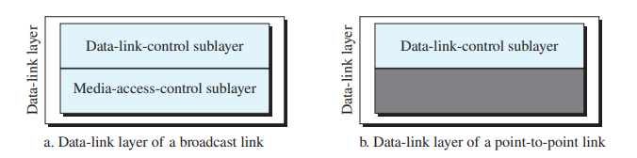
Data Link Sublayers
The Data-Link layer contains two sublayers that are described in the IEEE-802 LAN standards:
Data-Link Control (DLC)
Media Access Control (MAC)

Slide 8
Data Link Control
First we will discuss Data-link layer
Data-link control (DLC) deals with procedures for communication between two adjacent nodes—node-to-node communication—no matter whether the link is dedicated or broadcast
Framing
flow control
error control

Slide 9
Framing
The data link layer packs bits into frames, so that each frame is distinguishable from another
Framing in the data-link layer separates a message from one source to a destination by adding a sender address and a destination address.

Slide 10
Frame Size
Frame Size
Frames can be of fixed or variable size.
fixed-size framing
In fixed-size framing, there is no need to define the boundaries of the frames; the size itself can be used as a delimiter.
Variable-size framing
In variable-size framing, we need a way to define the end of one frame and the beginning of the next. Historically, two approaches have been used for this purpose:
character-oriented approach
bit-oriented approach.

Slide 11
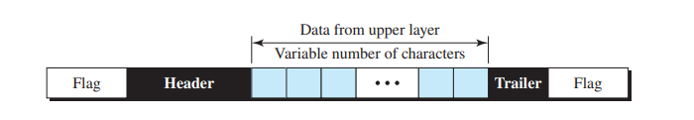
Character-Oriented Framing
Character-Oriented Framing
In character-oriented (or byte-oriented) framing, data to be carried are 8-bit characters from a coding system such as ASCII. The header, which normally carries the source and destination addresses and other control information, and the trailer, which carries error detection redundant bits, are also multiples of 8 bits. To separate one frame from the next, an 8-bit (1-byte) flag is added at the beginning and the end of a frame. The flag, composed of protocol-dependent special characters, signals the start or end of a frame.

Slide 12
Character-Oriented Framing
Byte-stuffing
Character-oriented framing was popular when only text was exchanged by the data-link layers. The flag could be selected to be any character not used for text communication. Now, however, we send other types of information such as graphs, audio, and video; any pattern used for the flag could also be part of the information. If this happens, the receiver, when it encounters this pattern in the middle of the data, thinks it has reached the end of the frame. To fix this problem, a byte-stuffing strategy was added to character-oriented framing. In byte stuffing (or character stuffing), a special byte is added to the data section of the frame when there is a character with the same pattern as the flag. The data section is stuffed with an extra byte. This byte is usually called the escape character (ESC) and has a predefined bit pattern. Whenever the receiver encounters the ESC character, it removes it from the data section and treats the next character as data, not as a delimiting flag.

Slide 13
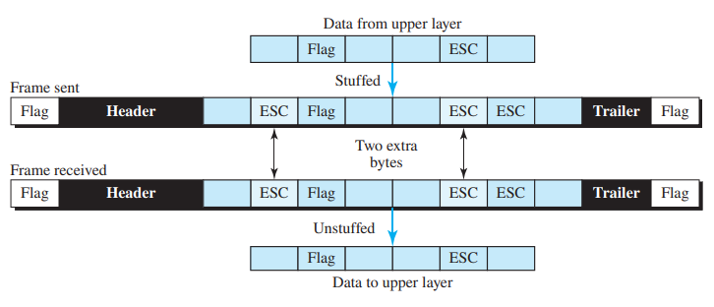
Character-Oriented Framing
Byte Stuffing and un-stuffing
What happens if the text contains one or more escape characters followed by a byte with the same pattern as the flag?
To solve this problem , if the escape character is part of the text, an extra one is added to show that the second one is part of the text
Byte stuffing is the process of adding one extra byte whenever there is a flag or escape character in the text.

Slide 14
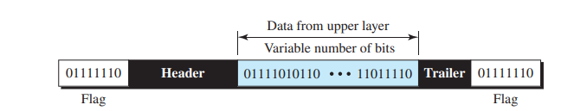
Bit-Oriented Framing
in bit-oriented framing, the data section of a frame is a sequence of bits to be interpreted by the upper layer as text, graphic, audio, video, and so on.
However, in addition to headers (and possible trailers), we still need a delimiter to separate one frame from the other. Most protocols use a special 8-bit pattern flag, 01111110, as the delimiter to define the beginning and end of the frame, as shown in Figure

Slide 15
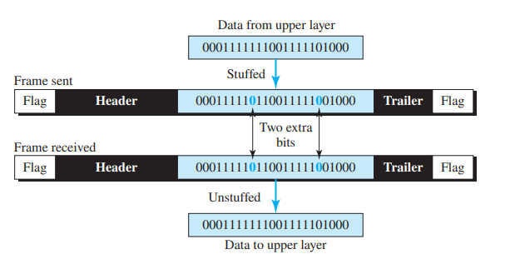
Bit Stuffing
This flag can create the same type of problem we saw in the character-oriented protocols. That is, if the flag pattern appears in the data, we need to somehow inform the receiver that this is not the end of the frame. We do this by stuffing one single bit (instead of one byte) to prevent the pattern from looking like a flag. The strategy is called bit stuffing.
Bit stuffing is the process of adding one extra 0 whenever five consecutive 1s follow a 0 in the data, so that the receiver does not mistake the pattern 0111110 for a flag

Slide 16
Flow Control
Flow control refers to a set of procedures used to restrict the amount of data that
the sender can send before waiting for acknowledgment
Ensuring the sending entity does not overwhelm the receiving entity
Preventing buffer overflow (giving ample time to the processor to process)

Slide 17
Error Control
Error control in the data link layer is based on automatic repeat request, which is
the retransmission of data.
Automatic repeat request (ARQ)
Error detection (Damaged Frames, Lost Frames)
Positive acknowledgment
Negative acknowledgement and retransmission
Retransmission after timeout

Slide 18
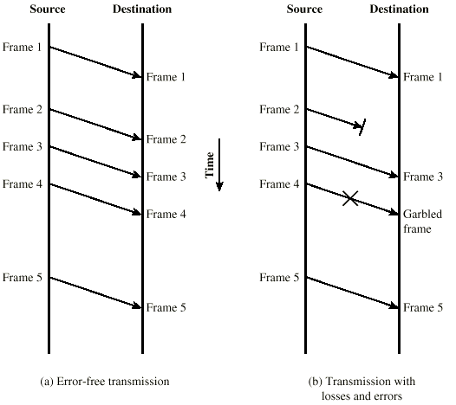
Model of Frame Transmission

Slide 19
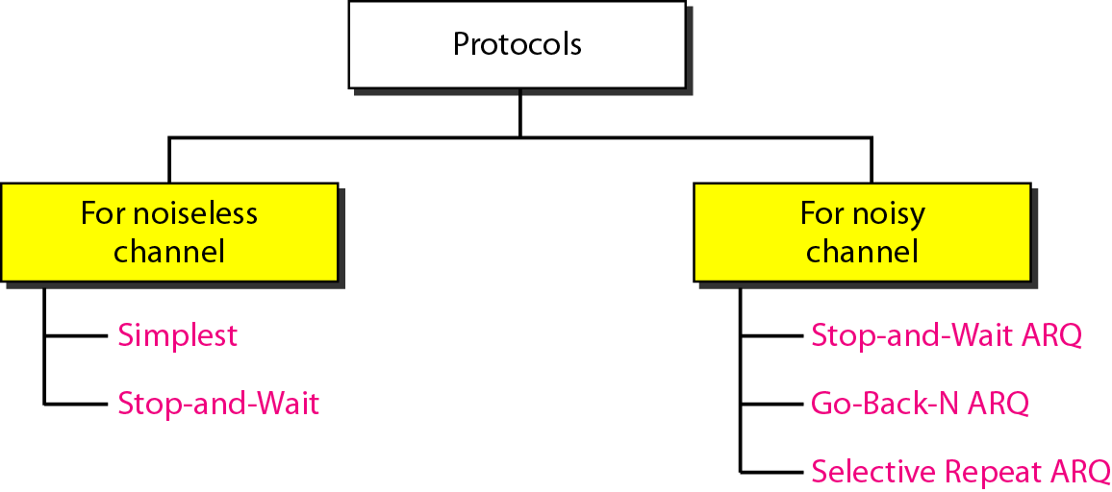
Data Link Control

Slide 20
Noiseless Channel
Let us assume we have an ideal channel in which no frames are lost, duplicated, or corrupted
For such a channel we have…
Simplest Method (no flow control)
Stop-and-Wait Method (with flow control)
None of the above have error control as they are for noiseless (ideal) channel

Slide 21
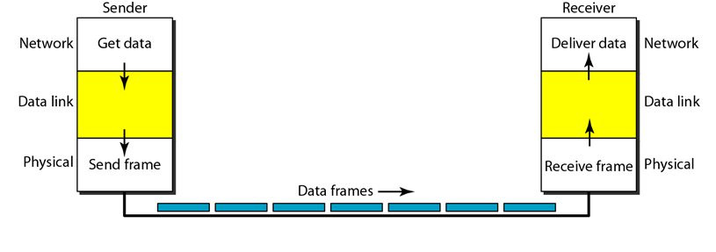
Simplest Method

Slide 22
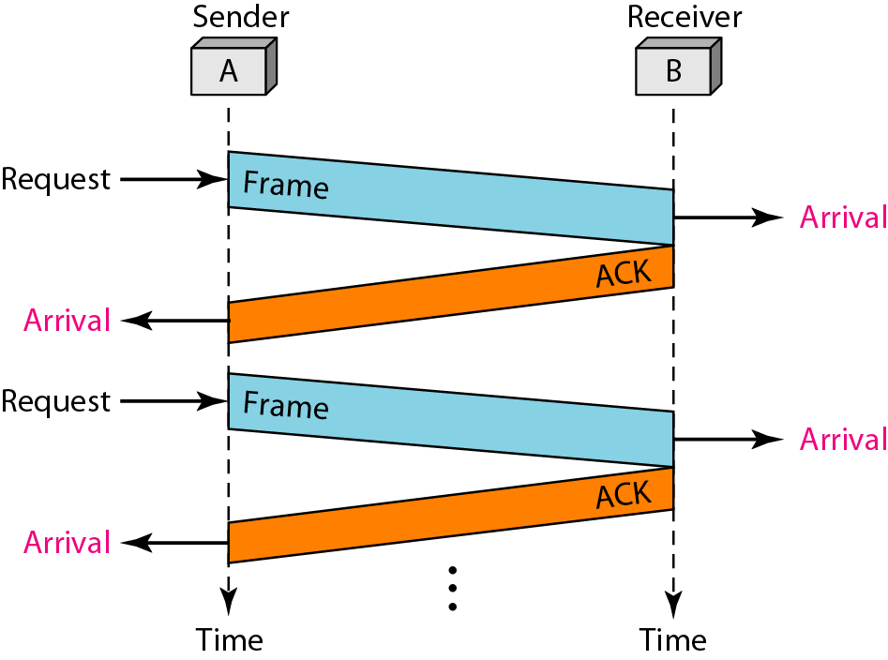
Stop-And-Wait
The sender sends one frame
Stops and Waits until it receives confirmation from the receiver
Then sends the next frame
Thus Flow Control

Slide 23
Noisy Channel
In reality noiseless (error-free) channels do not exist
Therefore, in noisy channel, we need error control as well
Error control in the data link layer is based on Automatic Repeat Request (ARQ)

Slide 24
Automatic Repeat Request (ARQ)
Stop and wait
Go back N
Selective repeat

Slide 25
Stop and Wait ARQ
It is the simplest (i) flow and (ii) error control mechanism
Source transmits frame & keeps a copy
Destination receives frame and replies with acknowledgement
Source waits for ACK before sending next frame

Slide 26
Stop and Wait ARQ
If received frame damaged, discard it
Transmitter has timeout
If no ACK within timeout, retransmit
Numbering the frames prevents the retaining of duplicate frames
ACK number defines the number of next expected frame
Use ACK0 and ACK1

Slide 27
Operation of Stop and Wait
We can have four different situations in the transmission of a frame:
Normal operation
Loss of frame (or Damaged frame)
Loss of ACK (or Damaged ACK)
Delay of ACK

Slide 28
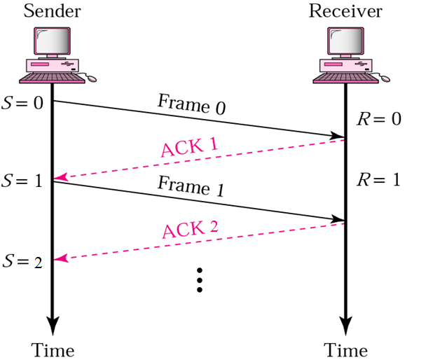
1. Normal Operation

Slide 29
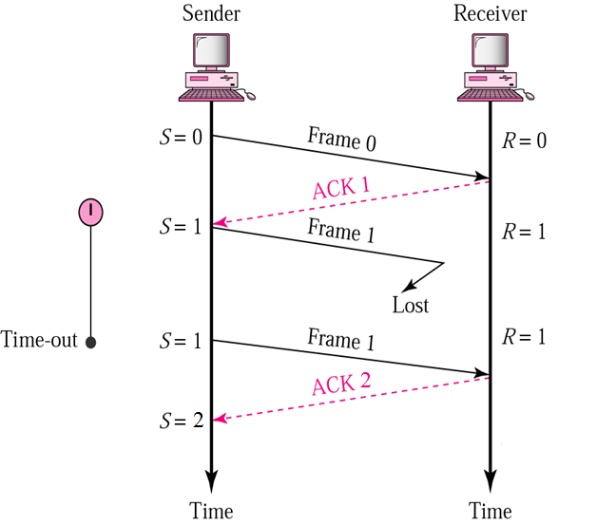
2. Lost or damaged frame
Lost or damaged frames are handled in the same manner (No ACK)

Slide 30
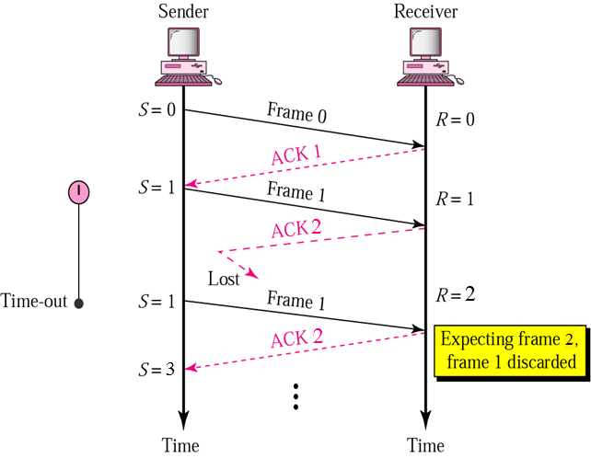
3. Lost or damaged ACK
If ACK damaged transmitter will not recognize it
Transmitter will retransmit
Receiver gets two copies of frame

Slide 31
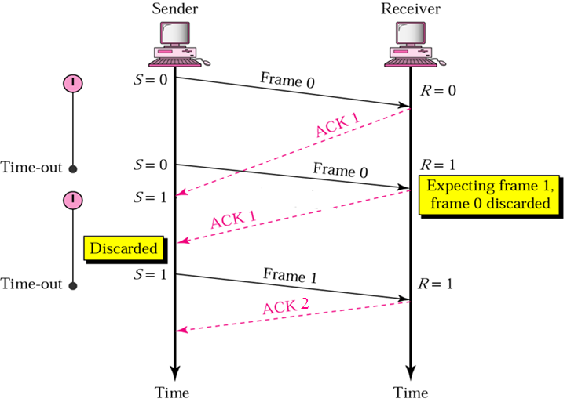
4. Delayed ACK

Slide 32
Go-back-N ARQ
Stop-and-Wait ARQ is simple but inefficient
To improve efficiency multiple frames should be in transition while waiting for ACK
Transmitter can send W frames without ACK
A copy of each frame is kept until ACK arrives
Each frame is numbered

Slide 33
Sliding Window
In sliding window method, multiple frames are sent by sender at a time before needing an acknowledgment
Sliding window refers to an imaginary boxes that hold the frames on both sender and receiver side.

Slide 34
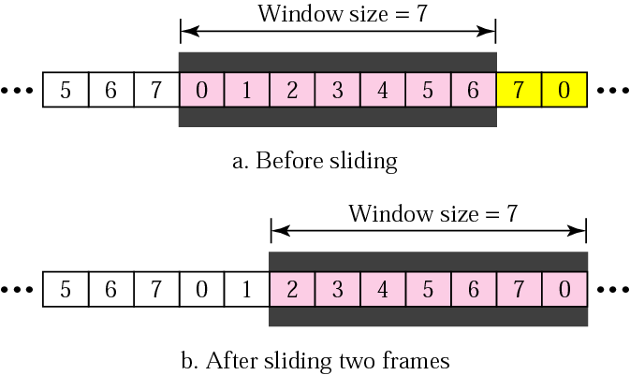
Sender sliding window
Sender uses a window to hold frames until ACK
Frames on left of window are acknowledged
Frames on right can’t be sent until window slides over

Slide 35
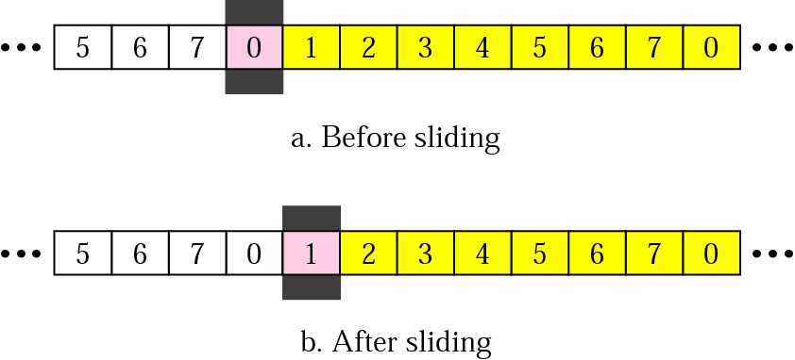
Receiver sliding window
The size of window at receiver is 1
The receiver is always waiting for a specific frame to arrive in a specific order

Slide 36
Go-Back-N Acknowledgment
If no error, ACK as usual with next frame expected
Receiver can send one cumulative ACK for several frames
If error,
Discard that frame and all future frames until error frame received correctly
Transmitter must go back and retransmit that frame and all subsequent frames i.e. Go-Back-N

Slide 37
Operation of Go-back-N
We can have four different situations in the transmission of a frame:
Normal operation
Loss of frame (or Damaged frame)
Loss of ACK (or Damaged ACK)
Delay of ACK

Slide 38
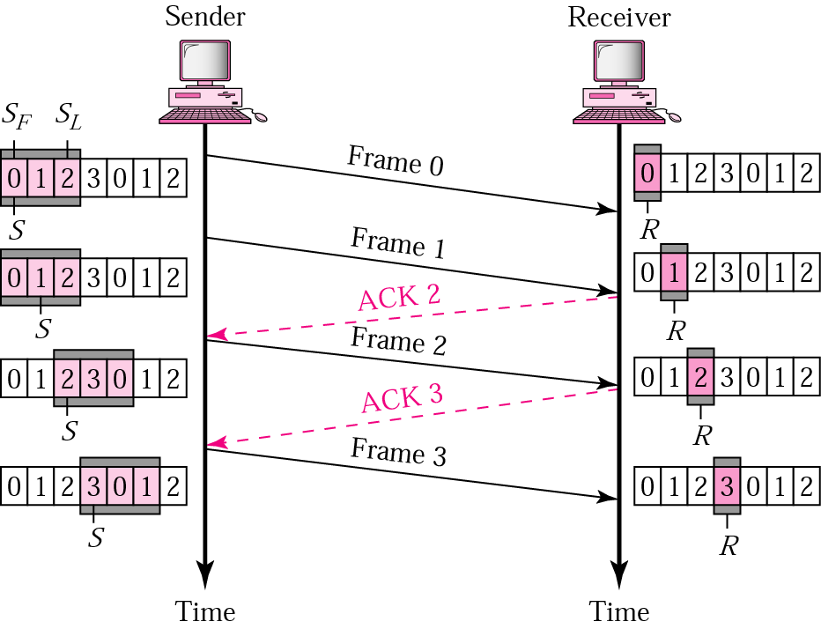
1. Normal Operation

Slide 39
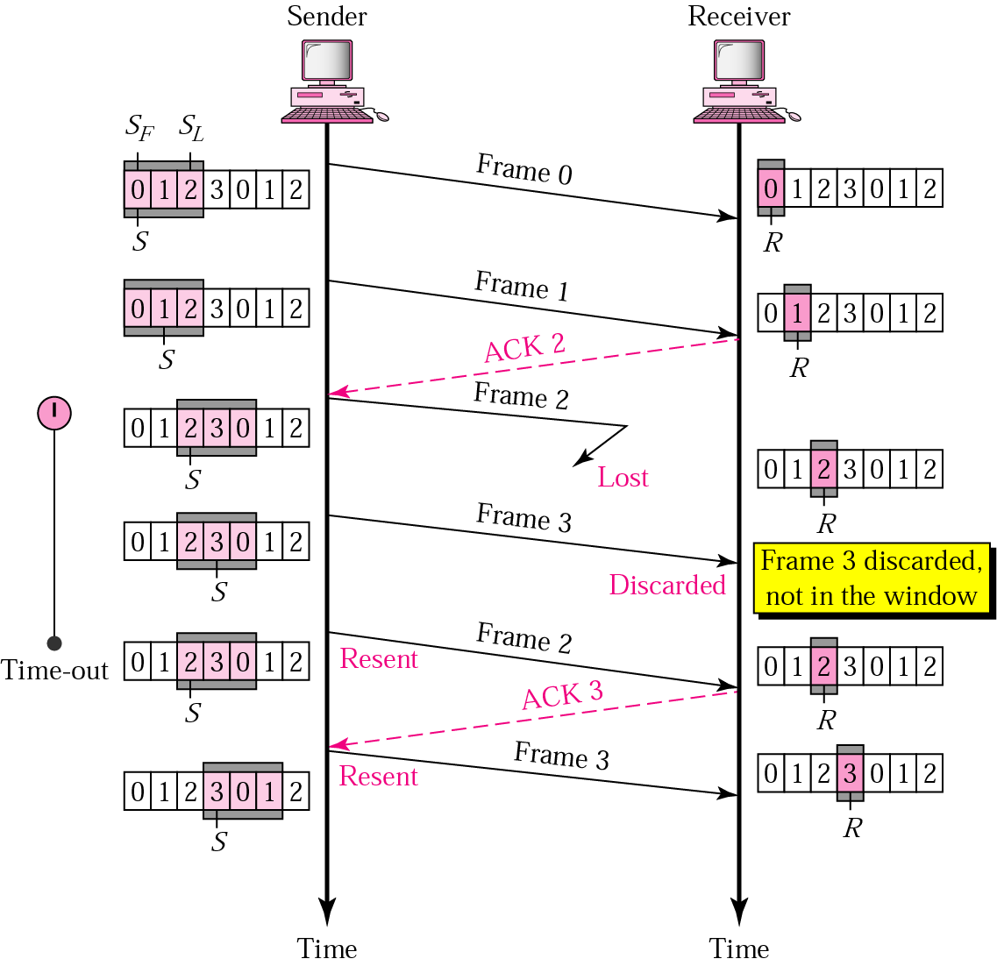
2. Lost or damaged frame

Slide 40
3 & 4. Lost or delayed ACK
If next ACK arrives before expiration of any timer then no retransmission
If next ACK arrives after timeout, the frame and all later frames will be retransmitted.

Slide 41
Selective Repeat ARQ
Go-back-N ARQ
simplifies the process at receiver site
very inefficient for a noisy channel (resending many frames when only one was damaged)
Solution: Selective Repeat ARQ
Processing at receiver is complex
More efficient for noisy links (resends damaged frames only)

Slide 42
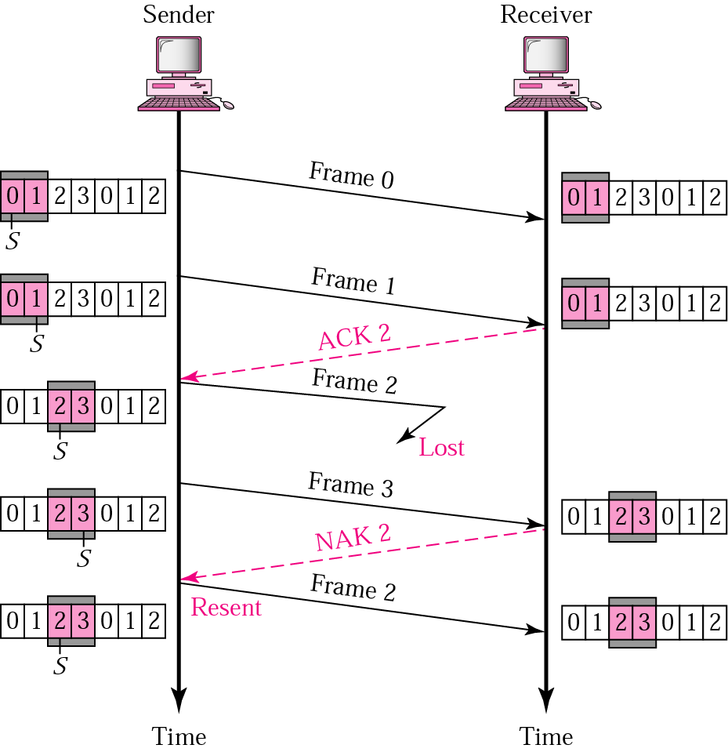
Lost frame

Slide 43
Bandwidth-Delay Product
“Efficiency of an ARQ system can be measured by the product of bandwidth (bps) and round-trip delay (sec)”
“It is a measure of the number of bits that can be sent out of a system while waiting for ACKs”

Slide 44
Example
In a Stop-and-Wait ARQ system, the bandwidth of the line is 1 Mbps, and 1 bit takes 20 ms to make a round trip. What is the bandwidth-delay product? If the system data frames are 1000 bits in length, what is the utilization percentage of the link?
Solution
The bandwidth-delay product is
1 × 10⁶ (bits/Sec) × 20 × 10⁻³ (Sec) = 20,000 bits
The system can send 20,000 bits during the time it takes for the data to go from the sender to the receiver and then back again. However, the system sends only 1000 bits. We can say that the link utilization is only 1000/20,000, or 5%. For this reason, for a link with high bandwidth or long delay, use of Stop-and-Wait ARQ wastes the capacity of the link.

Slide 45
Example
What is the utilization percentage of the link in the previous example if the link uses Go-Back-N ARQ with a 15-frame sequence?
Solution
The bandwidth-delay product is still 20,000. However , now the system can send up to 15 frames or 15,000 bits during a round trip. This means the utilization is 15,000/20,000, or 75 percent. Of course, if there are damaged frames, the utilization percentage is much less because (some) frames have to be resent.

Slide 46
THANK YOU

